Slide 1
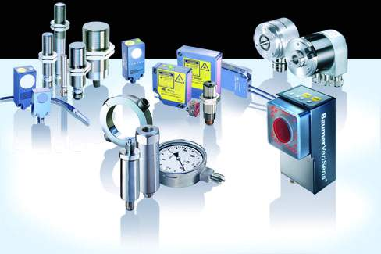
SENSORS

Slide 2
Sensors are also called as Transducers, which converts the given form of energy into electrical form.
TRANSDUCER
TEMPARATURE
ELECTRICAL FORM

Slide 3
TYPES OF SENSORS
Piezo electric sensor
Tilt sensor
Temperature sensor
Slot sensor
LPG sensor
PIR sensor
Magnetic sensor

Slide 4
PIEZO ELECTRIC SENSOR
A piezoelectric substance is one that produces an electric charge when a mechanical stress is applied (the substance is squeezed or stretched).
Conversely, a mechanical deformation (the substance shrinks or expands) is produced when an electric field is applied.

Slide 5

LDR
An LDR is an input transducer (sensor) which converts brightness (light) to resistance. It is made from cadmium sulphide (CdS) and the resistance decreases as the brightness of light falling on the LDR increases.

Slide 6
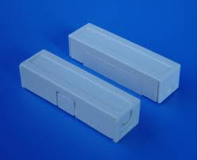
Magnetic Switch /Reed Switch
A magnetic switch, which consists of an enclosure and a contact

Slide 7
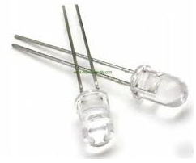
IR LED/PHOTO LED
It is a special purpose LED that transmits infrared rays in the range of 760 nm wavelength.
An IR LED is also known as IR transmitter.

Slide 8
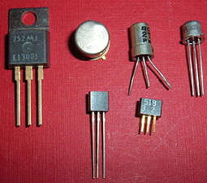
PHOTO TRANSISTOR
Like diodes, all transistors are light-sensitive. Phototransistors are designed specifically to take advantage of this fact.

Slide 9
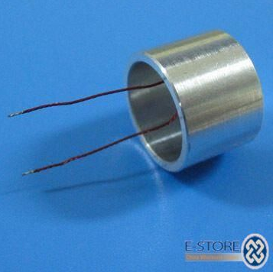
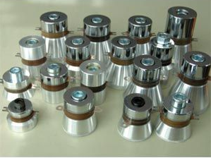
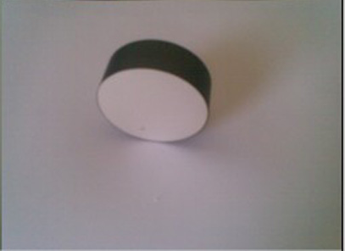

Slide 10
TILT SENSOR
A tilt sensor can measure the tilting in often two axes of a reference plane in two axes. In contrast, a full motion would use at least three axes and often additional sensors.
Application:
Tilt sensors can also be found in game controllers such as the Microsoft Sidewinder Freestyle Pro and Sony's PlayStation3 controller.

Slide 11
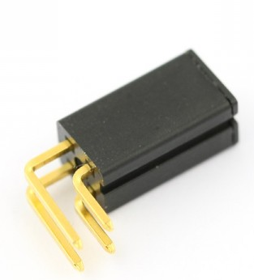
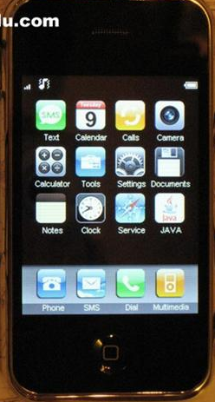

Slide 12
TEMPERATURE SENSOR
Temperature sensor converts the temperature into electrical signal called thermistor.
For examples transducer converts physical data such as temperature, light intensity ,flow and speed to electric signals.

Slide 13
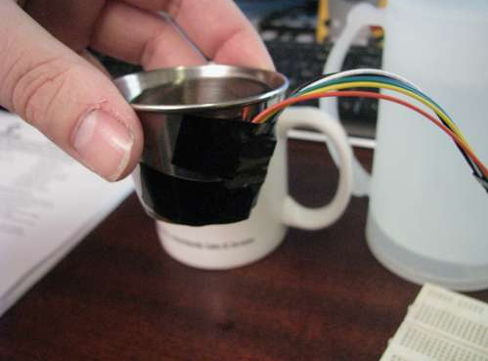
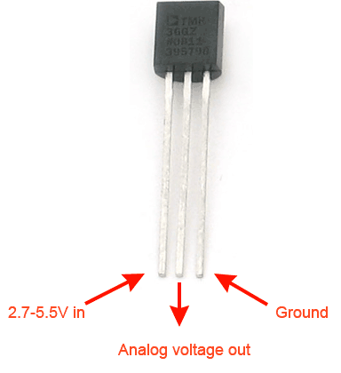
LM 35

Slide 14
SLOT SENSOR
The main feature of our slot sensors is their reliability with utmost accuracy.
Even very small objects are reliably detected.

Slide 15
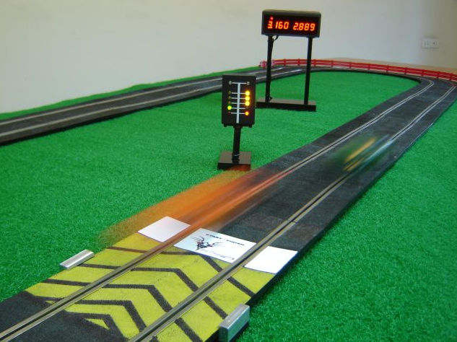
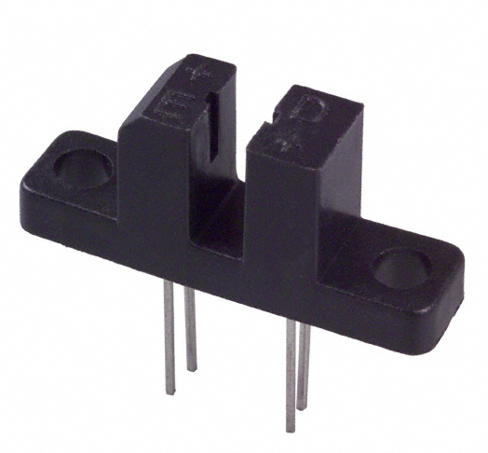

Slide 16
LPG SENSOR
LPG Sensor
Ideal sensor for use to detect the presence of a dangerous LPG leak in your car or in a service station, storage tank environment. This unit can be easily incorporated into an alarm unit, to sound an alarm or give a visual indication of the LPG concentration.
The sensor has excellent sensitivity combined with a quick response time. The sensor can also sense iso-butane, propane, LNG and cigarette smoke.

Slide 17
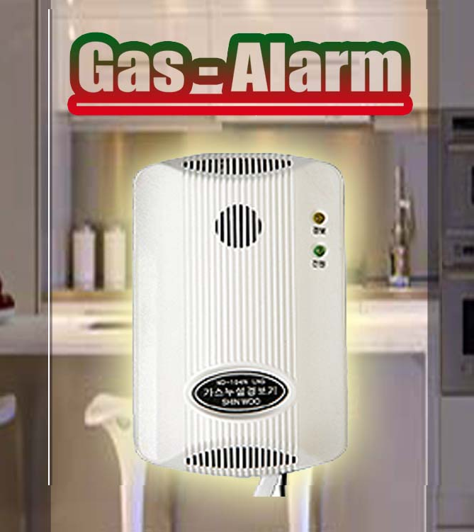
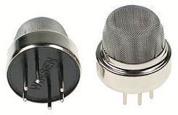

Slide 18
PIR SENSOR
The Passive Infrared Sensor (PIR) sensor module is used for motion detection. It can be used as motion detector for security systems or robotics.
It works form 3.3V to 5V DC and gives TTL output which can be directly given to microcontroller or to relay through a transistor.

Slide 19
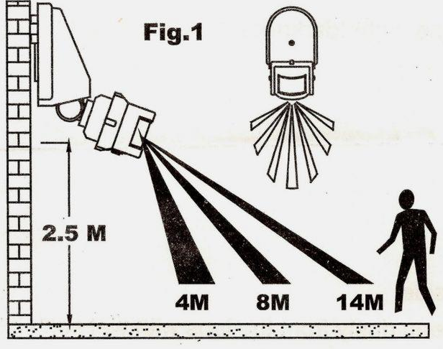
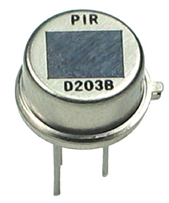

Slide 20
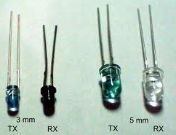
IR SENSOR
A Infrared sensor (IR sensor) is an electronic device that measures infrared (IR) light radiating from objects in its field of view.

Slide 21
BASICS OF OPERATIONAL AMPLIFIER

Slide 22
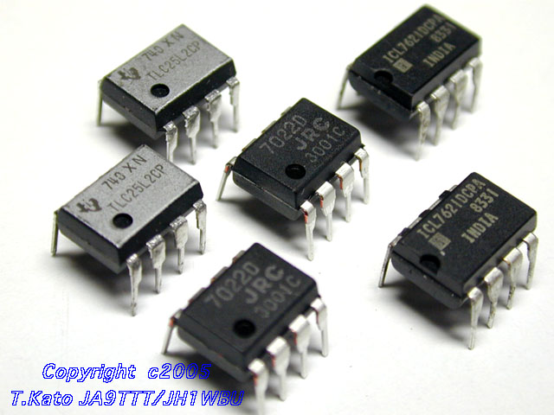
Operational Amplifiers

Slide 23
Op-amps (amplifiers/buffers in general) are drawn as a triangle in a circuit schematic
There are two input
Inverting and non-inverting
One output
Also power connections (note no explicit ground)

Slide 24
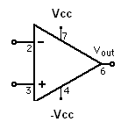
Operational Amplifiers
Five important pins
2 – The inverting input
3 – The non-inverting input
6 – The output
4 – The negative power supply V⁻ (-Vcc)
7 – The positive power supply V⁺ (+Vcc)

Slide 25
Op-Amp as Comparator
Operational Amplifiers were originally used for mathematical operations in analog computers.
They typically have two inputs, a positive(Non-Inverting) input and a Negative(Inverting) input.

Slide 26
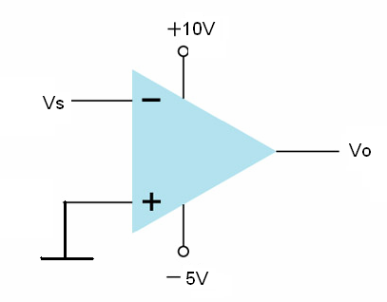
Application of Op-Amp –Triangular wave to square wave converter
(a) Input Voltage of Comparator
V_{S}(V)
t
Compare V⁺ and V⁻
V⁺=0
V⁻=V_{S}
When:
V_{S}>0,V⁺>V⁻ so V_{o}=10V
V_{S}<0,V⁺<V⁻ so V_{o}=-5V
V_{o}(V)
10
t
-5
(b) Output Voltage of Comparator

Slide 27
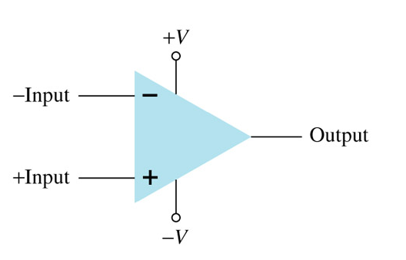

Slide 28
Why LM324 is preferred over LM741
If you use IC741 as comparator with Vcc=5V and -Vee=0 then for HIGH=4.5V and LOW=1.52, so in both condition transistor will be saturated, so in order to use IC741 as a comparator better apply -15,+15.
when LM324 is used with Vcc=5V then HIGH=3.6V(but this is the logic high for digital circuit) and LOW=0. So this will be better, you won't be able to get HIGH=5V.

Slide 29
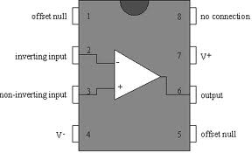
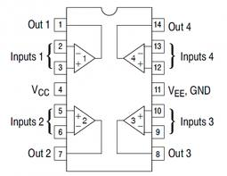
TERMINAL IDENTIFICATION OF LM741 & LM324
LM741
LM324

Slide 30
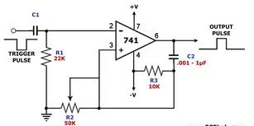
MONOSTABLE MULTIVIBRATOR
A multi vibrator is an electronic circuit used to implement a variety of simple two-state systems such as oscillators, timers and flip-flops.
Mono stable, in which one of the states is stable, but the other state is unstable (transient).

Slide 31
Applications of Monostable
Vibration security system
Sound based device
Switching

Slide 32
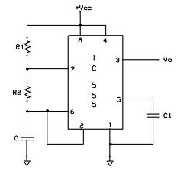
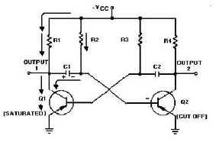
A stable Multivibrator -555IC
A stable in which the circuit is not stable in either state —it continually switches from one state to the other. It does not require an input such as a clock pulse.

Slide 33
Applications
Running light effects with LEDS
Electronics mosquito repellant

